Slide 1
Module 4: Explore modern data warehouse analytics

Slide 2
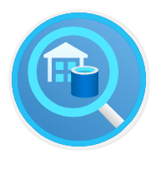
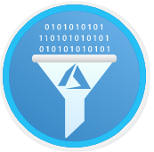
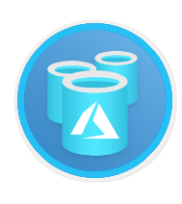
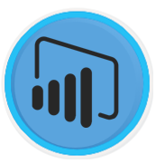
Agenda
Examine components of a modern data warehouse
Explore data ingestion in Azure
Explore data storage and processing in Azure
Get started building with Power BI

Slide 3
Lesson 1: Examine components of a modern data warehouse

Slide 4
Lesson 1 objectives
Explore data warehousing concepts
Explore Azure data services for modern data warehousing
Explore modern data warehousing architecture and workload
Explore Azure data services in the Azure portal
Notes:
Instructor notes
Ensure that all of your students fully understand the components and processes involved. This will be the focus of the module.

Slide 5
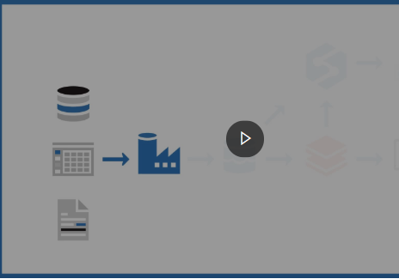
Demo: Modern data warehouse components
This video describes the components commonly used to create a data warehouse, and how data might flow through them. This video shows one particular approach
Notes:
Link: https://www.microsoft.com/videoplayer/embed/RE4A3RR

Slide 6
Azure services for the modern data warehouse
Azure Data Factory
Azure Data Lake
Azure Databricks
Azure HDInsight
Azure Synapse
Analytics
Notes:
Instructor notes
Azure Data Factory is a service that can ingest large amounts of raw, unorganized data from relational and non-relational systems, and convert this data into meaningful information.
Data Factory provides a scalable and programmable ingestion engine that you can use to implement complex hybrid extract-transform-load (ETL), extract-load-transform (ELT), and data integration projects.
Azure Data Lake is a collection of analytics and storage services that you can combine to implement a big data solution. It comprises three main elements: - Data Lake Store
- Data Lake Analytics
- HDInsight
Azure Databricks is an analytics platform optimized for the Microsoft Azure cloud services platform.
Designed with the founders of Apache Spark, Databricks is integrated with Azure to provide one-click setup, streamlined workflows, and an interactive workspace that enables collaboration between data scientists, data engineers, and business analysts.
Azure Synapse Analytics is generalized analytics service. You can use it to read data from many sources, process this data, generate various analyses and models, and save the results.
Azure HDInsight is a managed analytics service in the cloud. It's based on Apache Hadoop, a collection of open-source tools and utilities that enable you to run processing tasks over large amounts of data. HDInsight uses a clustered model, similar to that of Synapse Analytics.
HDInsight stores data using Azure Data Lake storage.
You can use HDInsight to analyze data using frameworks such as Hadoop Map/Reduce, Apache Spark, Apache Hive, Apache Kafka, Apache Storm, R, and more.

Slide 7
What is Azure Data Factory?
Azure Data Factory is described as a data integration service.
Retrieves data from more than one data source and converts it.
Filters out noise to keep interesting data
Work is defined as a pipeline operation – runs continuously as data is received
Notes:
Azure Data Factory is a service that can ingest large amounts of raw, unorganized data from relational and non-relational systems, and convert this data into meaningful information. Data Factory provides a scalable and programmable ingestion engine that you can use to implement complex hybrid extract-transform-load (ETL), extract-load-transform (ELT), and data integration projects.
Using Azure Data Factory, you can create and schedule data-driven workflows (called pipelines) that can ingest data from the disparate data stores used by the gaming company. You can build complex ETL processes that transform data visually with data flows or by using compute services such as Azure HDInsight, Azure Databricks, and Azure SQL Database. You can then publish the transformed data to Azure Synapse Analytics for business intelligence applications to consume.

Slide 8
What is Azure Data Lake Storage?
Azure Data Lake Storage is a repository of data for your modern data warehouse.
Organizes data into directories for improved file access.
Supports POSIX and RBAC permissions.
Compatible with the Hadoop Distributed File System
Notes:
Data Lake Storage organizes your files into directories and subdirectories for improved file organization. Blob storage can only mimic a directory structure.
Azure Data Lake Store provides granular security over data, using Access Control Lists. An Access Control List specifies which accounts can access which files and folders in the store. If you are more familiar with Linux, you can use POSIX (Portable Operating System Interface)-style permissions to grant read, write, and search access based on file ownership and group membership of users
Also, you can use directory permissions to enable granular Role-Based Access Control (RBAC) on your data.
Azure Data Lake Storage is compatible with the Hadoop Distributed File System (HDFS). Hadoop is highly flexible and programmable analysis service, used by many organizations to examine large quantities of data. All Apache Hadoop environments can access data in Azure Data Lake Storage Gen2.

Slide 9
What is Azure Databricks?
Azure Databricks is an Apache Spark-based platform that provides big data processing and streaming.
Simplifies the provisioning and collaboration of Apache spark-based analytical solutions.
Utilizes the security capabilities of Azure.
Integrates with a variety of Azure data platform services and Power BI.
Notes:
Instructor notes
Azure Databricks is an analytics platform optimized for the Microsoft Azure cloud services platform. Designed with the founders of Apache Spark, Databricks is integrated with Azure to provide one-click setup, streamlined workflows, and an interactive workspace that enables collaboration between data scientists, data engineers, and business analysts.
Apache Spark is a highly efficient data processing engine that can consume and process large amounts of data very quickly. There are a significant number of Spark libraries you can use to perform tasks such as SQL processing, aggregations, and to build and train machine learning models using your data.
Azure Databricks provides a graphical user interface where you can define and test your processing step by step, before submitting it as a set of batch tasks. You can create Databricks scripts and query data using languages such as R, Python, and Scala. You write your Spark code using notebooks. A notebook contains cells, each of which contains a separate block of code. When you run a notebook, the code in each cell is passed to Spark in turn for execution.

Slide 10
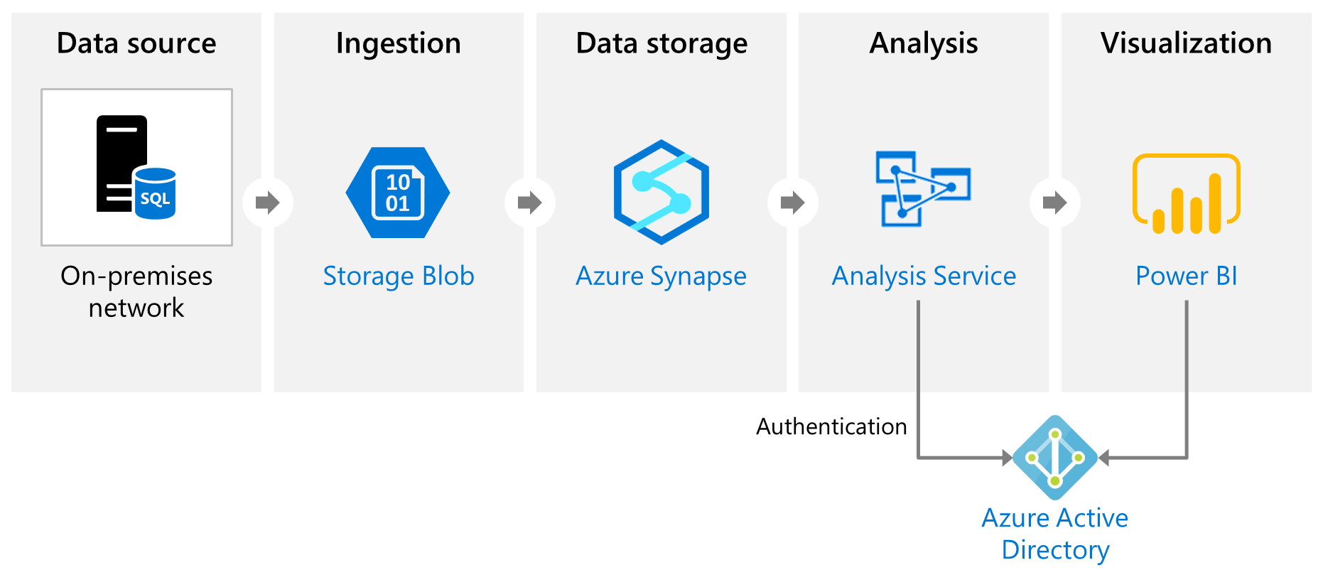
What is Azure Analysis Services?
Azure Analysis Services builds tabular models to support online analytical processing (OLAP) queries. It can combine data from multiple sources, including Azure SQL Database, Azure Synapse Analytics, Azure Data Lake Store, Azure Cosmos DB and others.
Notes:
Instructor notes
Azure Analysis Services enables you to build tabular models to support online analytical processing (OLAP) queries. You can combine data from multiple sources, including Azure SQL Database, Azure Synapse Analytics, Azure Data Lake store, Azure Cosmos DB, and many others. You use these data sources to build models that incorporate your business knowledge.
Analysis Services includes a graphical designer to help you connect data sources together and define queries that combine, filter, and aggregate data. You can explore this data from within Analysis Services, or you can use a tool such as Microsoft Power BI to visualize the data presented by these models.

Slide 11
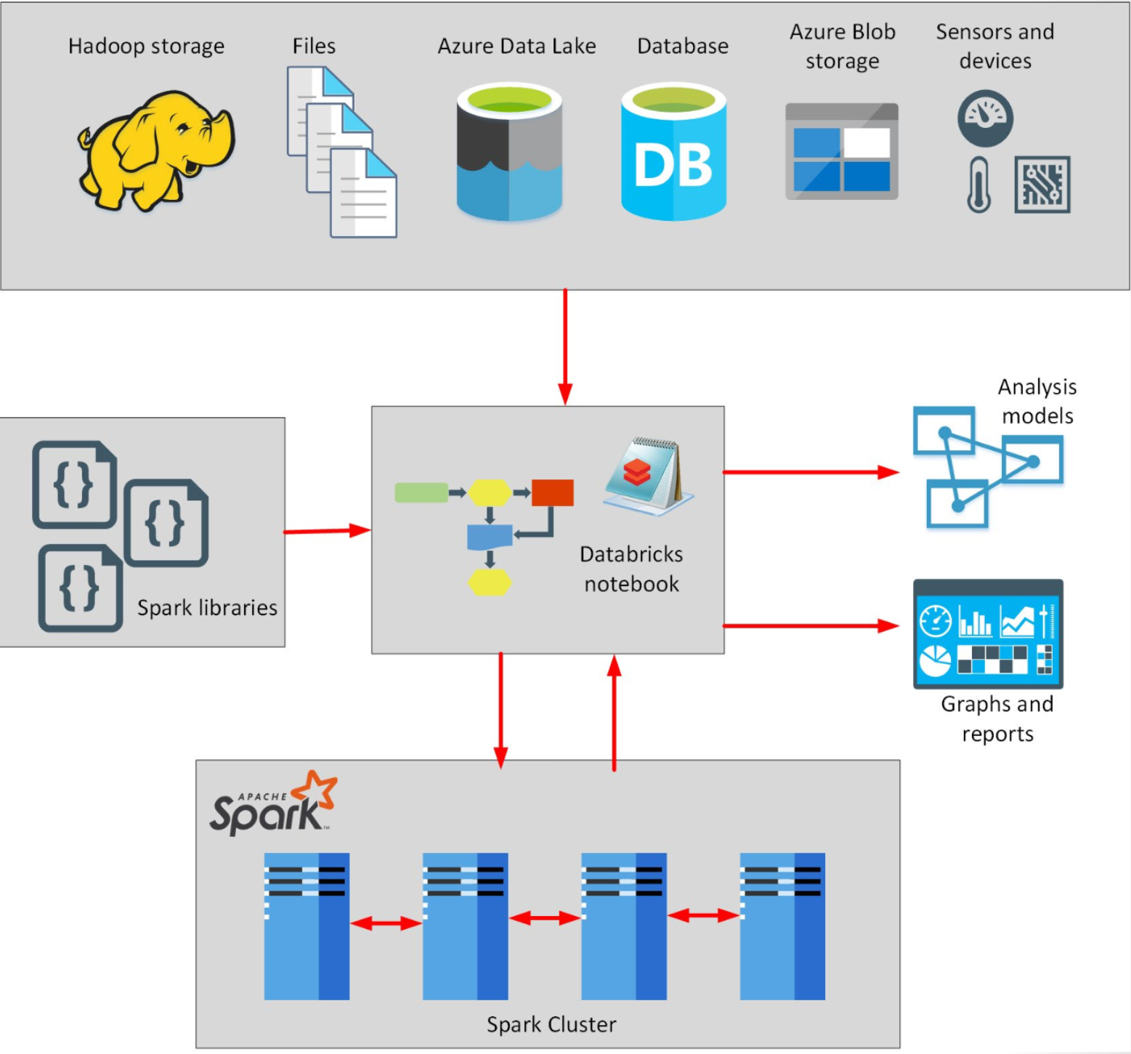
What is Azure HDInsight?
Azure HDInsight is a big data processing services which allows you to use open-source libraries on the one platform, in an Azure environment.
Notes:
Instructor notes
Azure HDInsight is a managed analytics service in the cloud. It's based on Apache Hadoop, a collection of open-source tools and utilities that enable you to run processing tasks over large amounts of data. HDInsight uses a clustered model, similar to that of Synapse Analytics. HDInsight stores data using Azure Data Lake storage. You can use HDInsight to analyze data using frameworks such as Hadoop Map/Reduce, Apache Spark, Apache Hive, Apache Kafka, Apache Storm, R, and more.

Slide 12

Lesson 1: Knowledge check
When should you use Azure Synapse Analytics?
To perform very complex queries and aggregations
To create dashboards from tabular data
To enable large number of users to query analytics data
What is the purpose of data ingestion?
To perform complex data transformations over data received from external sources
To capture data flowing into a data warehouse system as quickly as possible
To visualize the results of data analysis
What is the primary difference between a data lake and a data warehouse?
A data lake contains structured information, but a data warehouse holds raw business data
A data lake holds raw data, but a data warehouse holds structured information
Data stored in a data lake is dynamic, but information stored in a data warehouse is static

Slide 13
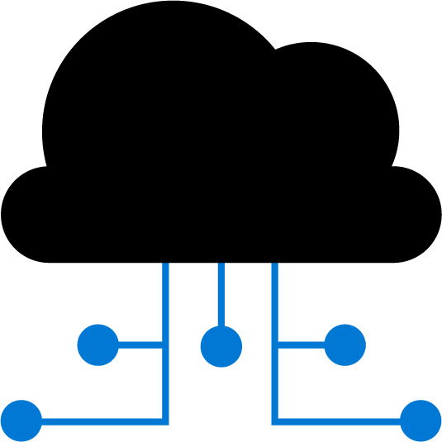
Lesson 2: Explore data ingestion in Azure

Slide 14
Lesson 2 objectives
Describe data ingestion in Azure
Describe components of Azure Data Factory
See how to use Azure Data Factory to load data into a data warehouse
Notes:
Instructor notes
Ensure that all of your students fully understand the components and processes involved. This will be the focus of the module.

Slide 15
Describe data ingestion in Azure
ADF
PolyBase
SSIS
70
100
80
Heterogenous
File based
Heterogenous
Notes:
Instructor notes
Azure Data Factory is a data ingestion and transformation service that allows you to load raw data from many different sources, both on-premises and in the cloud.
As it ingests the data, Data Factory can clean, transform, and restructure the data, before loading it into a repository such as a data warehouse. Once the data is in the data warehouse, you can analyze it.
PolyBase is a feature of SQL Server and Azure Synapse Analytics that enables you to run Transact-SQL queries that read data from external data sources. PolyBase makes these external data sources appear like tables in a SQL database.
Using PolyBase, you can read data managed by Hadoop, Spark, and Azure Blob Storage, as well as other database management systems such as Cosmos DB, Oracle, Teradata, and MongoDB.
SQL Server Integration Services (SSIS) is a platform for building enterprise-level data integration and data transformations solutions.
You can use SSIS to solve complex business problems by copying or downloading files, loading data warehouses, cleaning and mining data, and managing SQL database objects and data. SSIS is part of Microsoft SQL Server.
Databricks can process data held in many different types of storage, including Azure Blob storage, Azure Data Lake Store, Hadoop storage, flat files, SQL databases, and data warehouses, and Azure services such as Cosmos DB. Databricks can also process streaming data. For example, you could capture data being streamed from sensors and other devices.

Slide 16


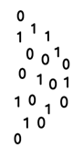


Describe components of Azure Data Factory
Linked Service
Triggers
@
Parameters
IR
Integration Runtime
Data Lake Store
Pipeline
CF
Control Flow
1
Activities
Azure Databricks
Dataset
Notes:
Instructor notes
Azure Data Factory can incorporate Azure Databricks notebooks into a pipeline. A pipeline can pass parameters to a notebook. These parameters can specify which data to read and analyze. The notebook can save the results, which the Azure Data Factory pipeline can use in subsequent activities.

Slide 17
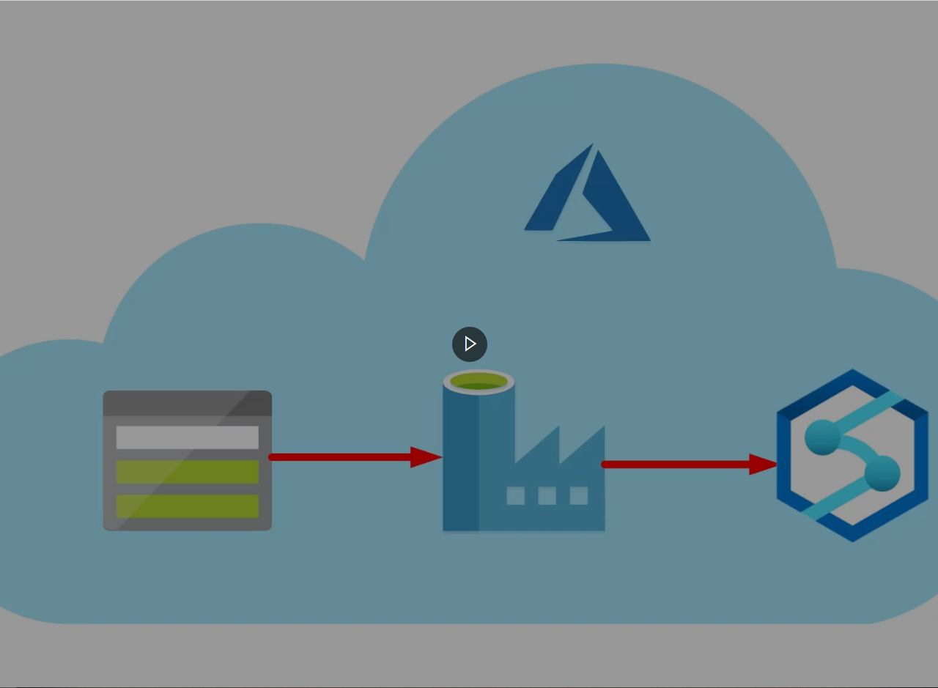
Demo: Load data into Azure Synapse Analytics
Imagine that you’re part of a team that is analyzing house price data. The dataset that you receive contains house price information for several regions. Your team needs to report on how the house prices in each region have varied over the last few months. To achieve this, you need to ingest the data into Azure Synapse Analytics. You’ve decided to use Azure Data Factory to perform this task
In this video, you’ll see how to use Azure Data Factory to ingest and process house price data for analysis
You’ll store the data in Azure Synapse Analytics for later analysis
Notes:
Link: https://www.microsoft.com/videoplayer/embed/RE4Asf7

Slide 18
Lesson 2: Knowledge check
Which component of an Azure Data Factory can be triggered to run data ingestion tasks?
CSV File
Pipeline
Linked service
When might you use PolyBase?
To query data from external data sources from Azure SQL Database
To ingest streaming data using Azure Databricks
To orchestrate activities in Azure Data Factory
Which of these services can be used to ingest data into Azure Synapse Analytics?
Azure Data Factory
Power BI
Azure Active Directory

Slide 19
Lesson 3: Explore data storage and processing in Azure

Slide 20
Lesson 3 objectives
Describe data processing options for performing analytics in Azure
Explore Azure Synapse Analytics
Notes:
Instructor notes
Ensure that all of your students fully understand the components and processes involved. This will be the focus of the module.

Slide 21
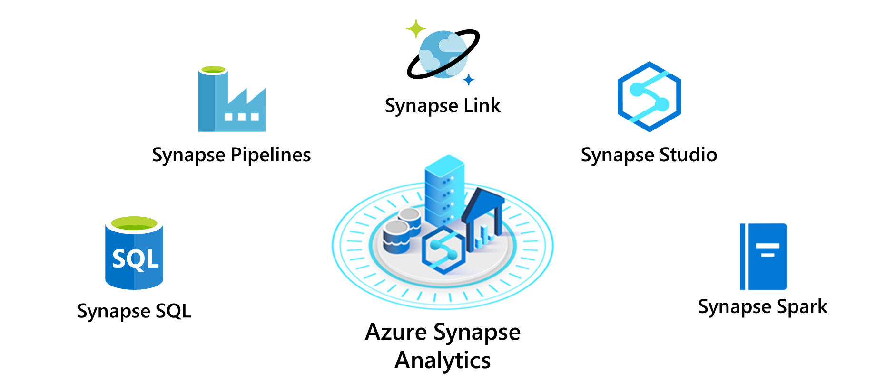
Explore Azure Synapse Analytics
Notes:
Instructor notes
- Synapse SQL pool: This is a collection of servers running Transact-SQL. Transact-SQL is the dialect of SQL used by Azure SQL Database, and Microsoft SQL Server. You write your data processing logic using Transact-SQL.
- Synapse Spark pool: This is a cluster of servers running Apache Spark to process data.
You write your data processing logic using one of the four supported languages: Python, Scala, SQL, and C# (via .NET for Apache Spark). Spark pools support Azure Machine Learning through integration with the SparkML and AzureML packages.
- Synapse Pipelines: A Synapse pipeline is a logical grouping of activities that together perform a task.
The activities in a pipeline define actions to perform on your data. For example, you might use a copy activity to transform data from a source dataset to a destination dataset. You could include activities that transform the data as it is transferred, or you might combine data from multiple sources together.
- Synapse Link: This component allows you to connect to Cosmos DB. You can use it to perform near real-time analytics over the operational data stored in a Cosmos DB database.
- Synapse Studio: This is a web user interface that enables data engineers to access all the Synapse Analytics tools. You can use Synapse Studio to create SQL and Spark pools, define and run pipelines, and configure links to external data sources.

Slide 22
Lesson 3: Knowledge check
You have a large amount of data held in files in Azure Data Lake storage. You want to retrieve the data in these files and use it to populate tables held in Azure Synapse Analytics. Which processing option is most appropriate?
Use Azure Synapse Link to connect to Azure Data Lake storage and download the data
Synapse SQL pool
Synapse Spark pool
Which of the components of Azure Synapse Analytics allows you to train AI models using AzureML?
Synapse Studio
Synapse Pipelines
Synapse Spark
In Azure Databricks how do you change the language a cell uses?
The first line in the cell is %language. For example, %scala
Change the notebook language before writing the commands
Wrap the command in the cell with ##language##

Slide 23
Lesson 4: Get started building with Power BI

Slide 24
Lesson 4 objectives
Learn how Power BI services and applications work together
Explore how Power BI can make your business more efficient
Learn how to create compelling visuals and reports
Notes:
Instructor notes
Ensure that all of your students fully understand the components and processes involved. This will be the focus of the module.

Slide 25
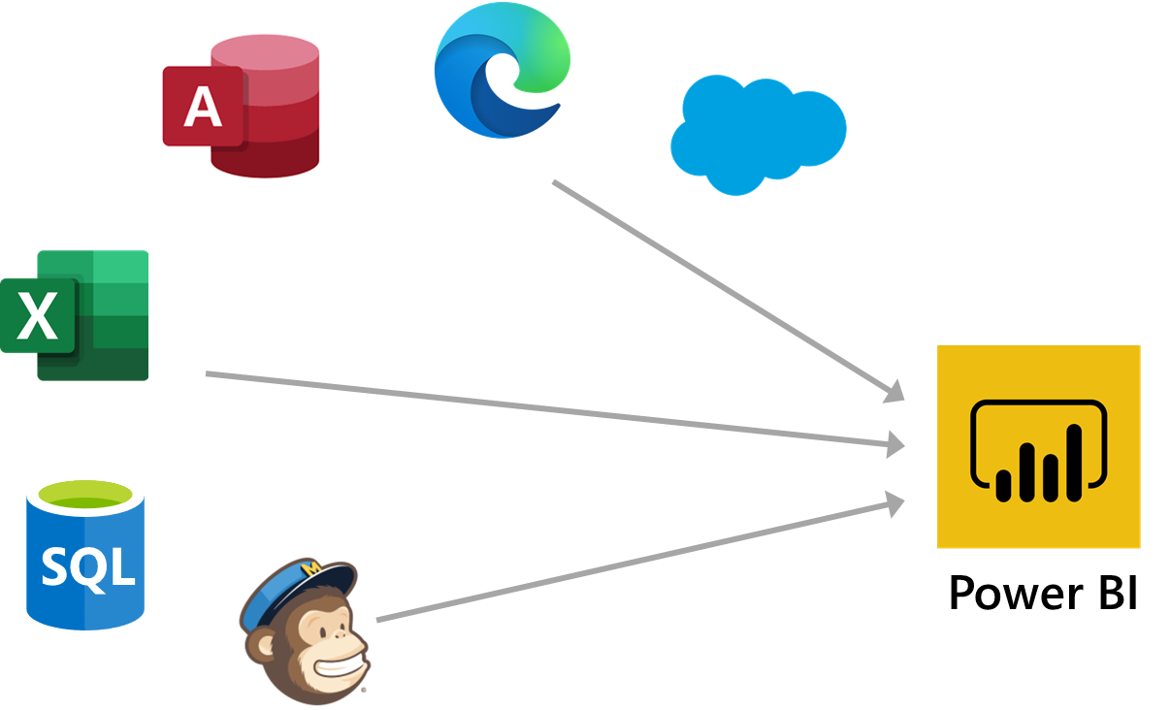
What is Power BI?
Notes:
Instructor notes
Here are the basic building blocks in Power BI:
* Visualizations
* Datasets
* Reports
* Dashboards
* Tiles
1. Bring data into Power BI Desktop as a dataset and create a report.
2. Publish to the Power BI service, where you can create new tiles and visualizations or build dashboards.
3. Share dashboards with others, especially people who are on the go.
4. View and interact with shared dashboards and reports in Power BI Mobile apps.

Slide 26
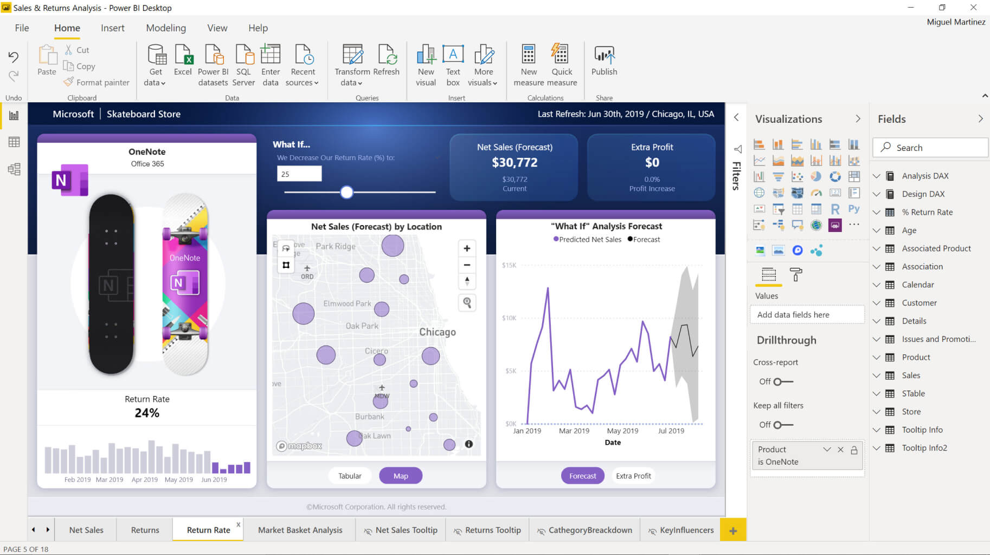
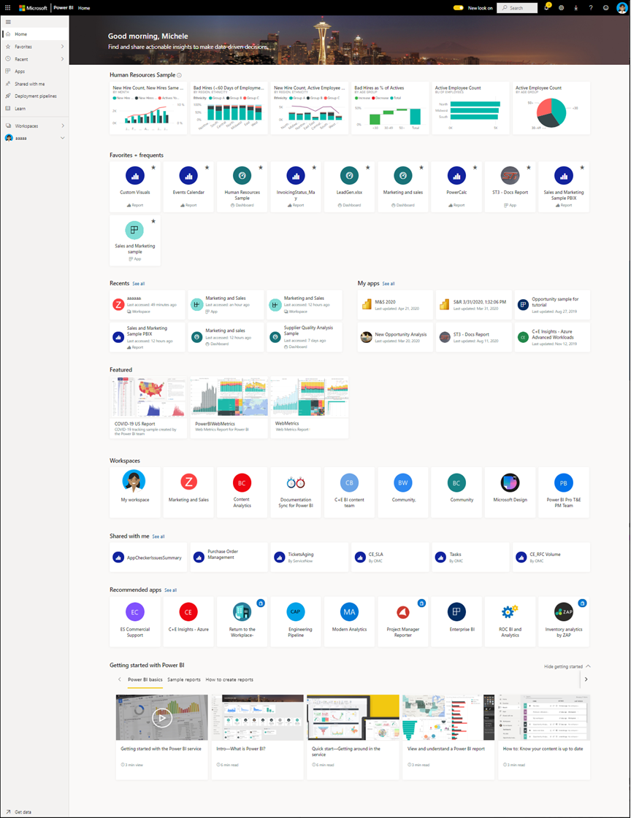
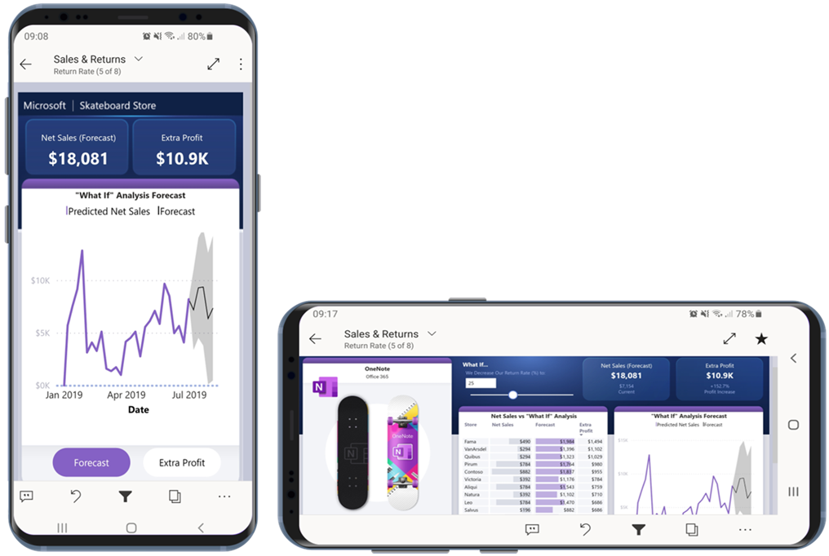
How can you use Power BI?
Power BI Desktop
Power BI Service
Animated Slide
Power BI Mobile
Notes:
Instructor notes
There are a few elements of Power BI, with three being:
The windows application called ‘Power BI Desktop’
The Online SaaS Service called ‘Power BI Service’
The Power BI apps for Windows, iOS and Android.
There is also the Power BI Report Builder, to create reports to share via the Power BI Service
and the Power BI Report Server, an on-prem server where you can publish your Power BI reports after creating it via Power BI Desktop

Slide 27
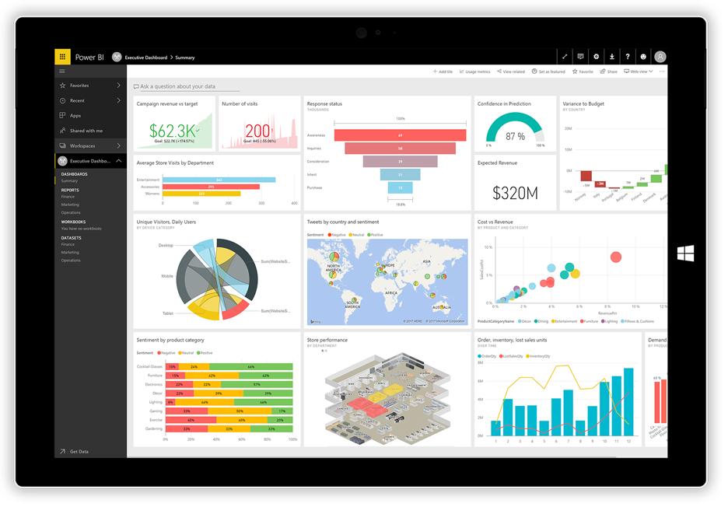
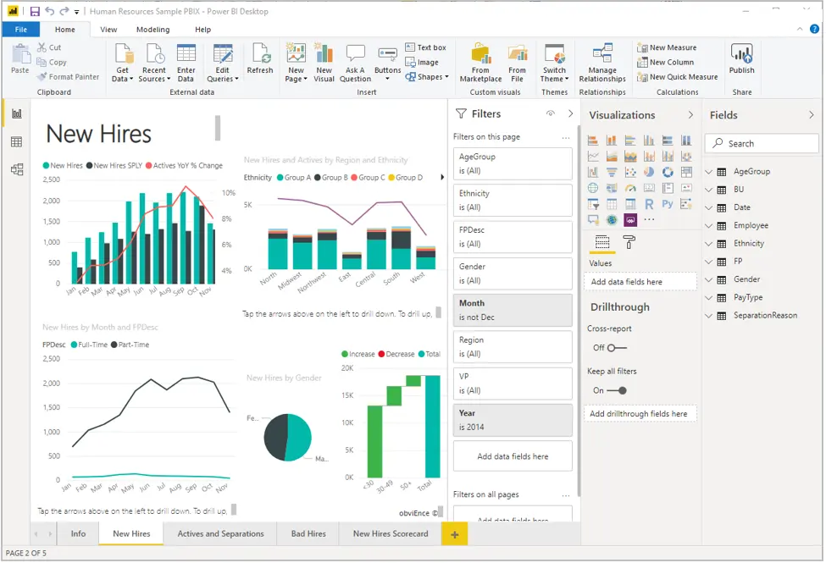
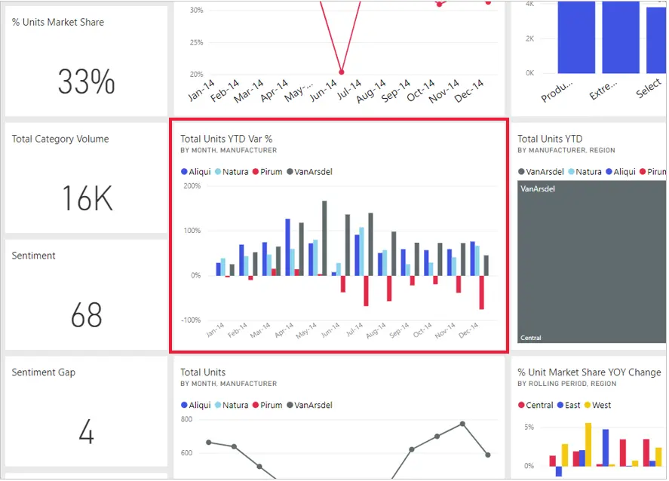
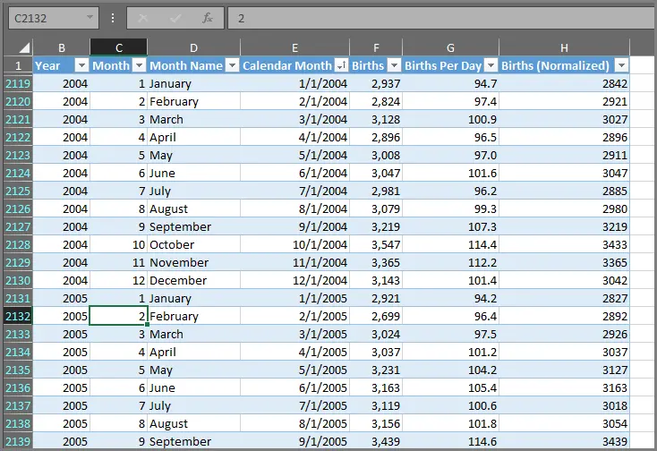
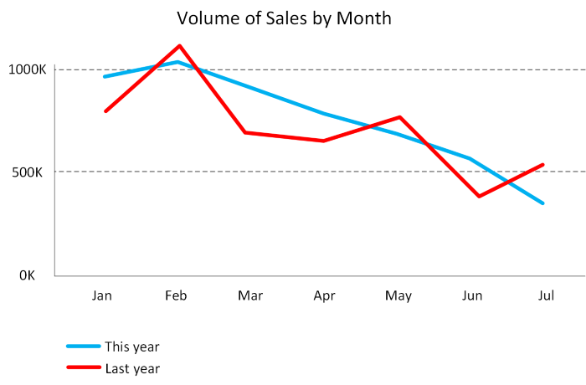
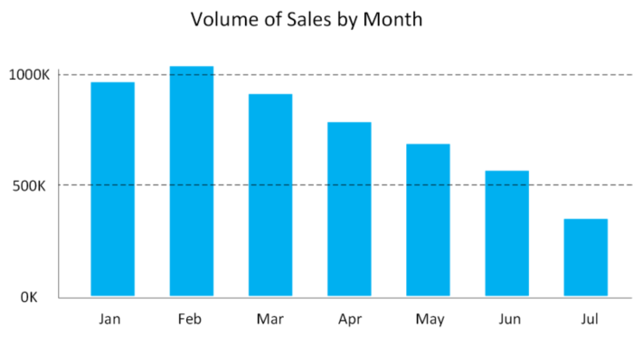
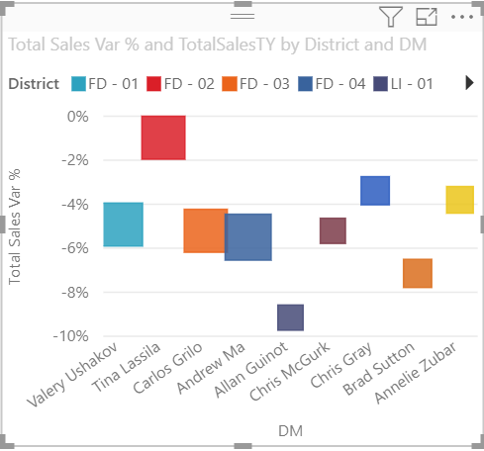
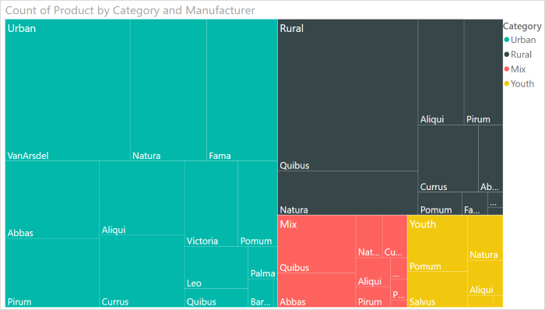
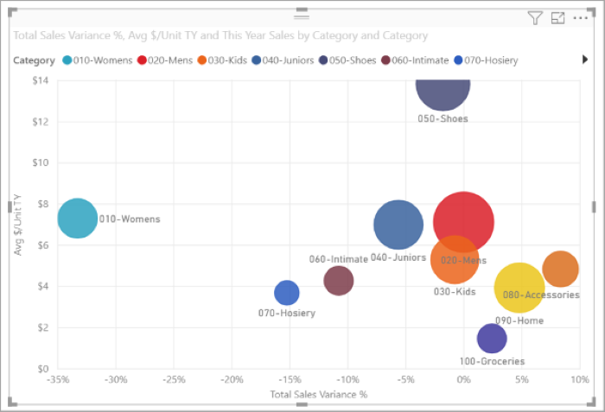
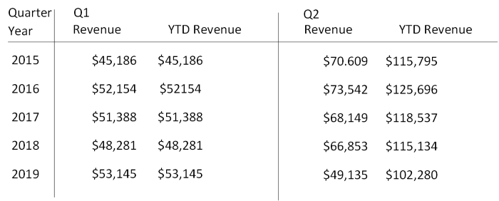
The anatomy of a Power BI app
Visualizations
Datasets
Reports
Dashboards
Animated Slide
Tiles
Notes:
Visualization (sometimes also referred to as a visual) is a visual representation of data, like a chart, a color-coded map, or other interesting things you can create to represent your data visually. Power BI has all sorts of visualization types, and more are coming all the time.
A dataset is a collection of data that Power BI uses to create its visualizations. Datasets can also be a combination of many different sources, which you can filter and combine to provide a unique collection of data (a dataset) for use in Power BI.
In Power BI, a report is a collection of visualizations that appear together on one or more pages. Just like any other report you might create for a sales presentation or write for a school assignment, a report in Power BI is a collection of items that are related to each other.
When you're ready to share a single page from a report, or a collection of visualizations, you create a dashboard. Much like the dashboard in a car, a Power BI dashboard is a collection of visuals from a single page that you can share with others. Often, it's a selected group of visuals that provide quick insight into the data or story you're trying to present.
In Power BI, a tile is a single visualization on a report or a dashboard. It's the rectangular box that holds an individual visual. In the following image, you see one tile, which is also surrounded by other tiles.

Slide 28
Lesson 4: Knowledge check
What is the common flow of activity in Power BI?
Create a report in Power BI mobile, share it to the Power BI Desktop, view and interact in the Power BI service
Create a report in the Power BI service, share it to Power BI mobile, interact with it in Power BI Desktop
Bring data into Power BI Desktop and create a report, share it to the Power BI service, view and interact with reports and dashboards in the service and Power BI mobile
Bring data into Power BI mobile, create a report, then share it to Power BI Desktop
Which of the following are building blocks of Power BI?
Tiles, dashboards, databases, mobile devices
Visualizations, datasets, reports, dashboards, tiles
Visual Studio, C#, and JSON files
A collection of ready-made visuals, pre-arranged in dashboards and reports is called what in Power BI?
The canvas
Scheduled refresh
An app

Slide 29
Closing slide

